Slide 1
Hungry Alarm
Team 1
https://github.com/CindyChenx/hungry-alarm

Slide 2
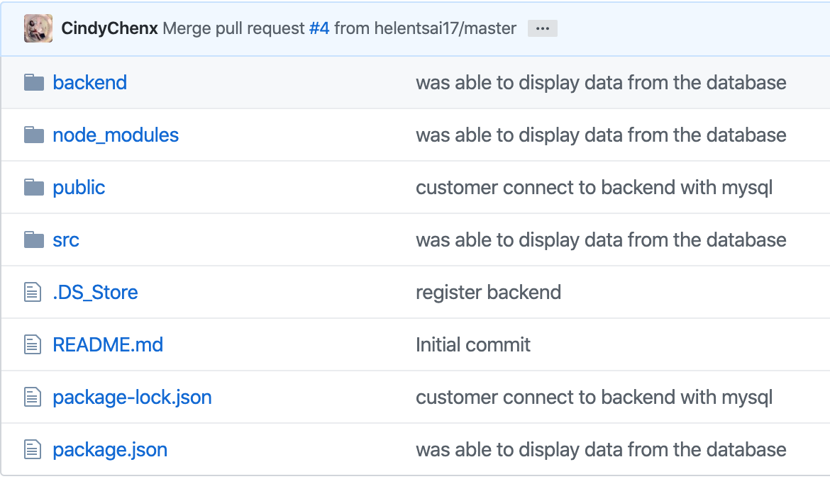
Github Repo Overall Structure

Slide 3
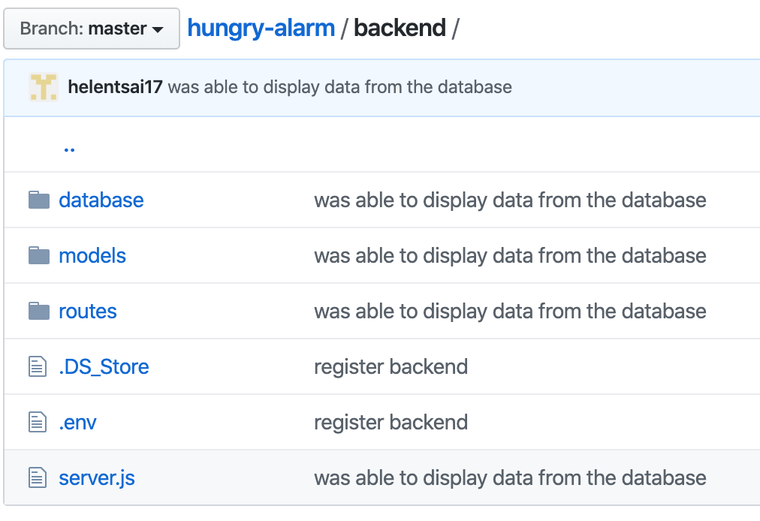
Backend Structure

Slide 4
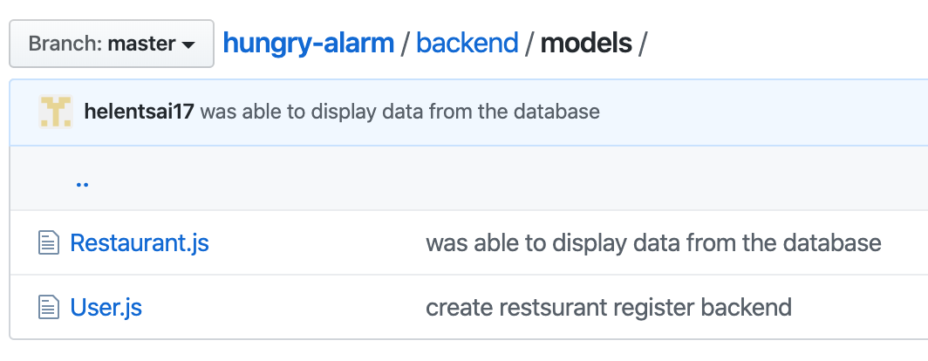
Backend Models

Slide 5
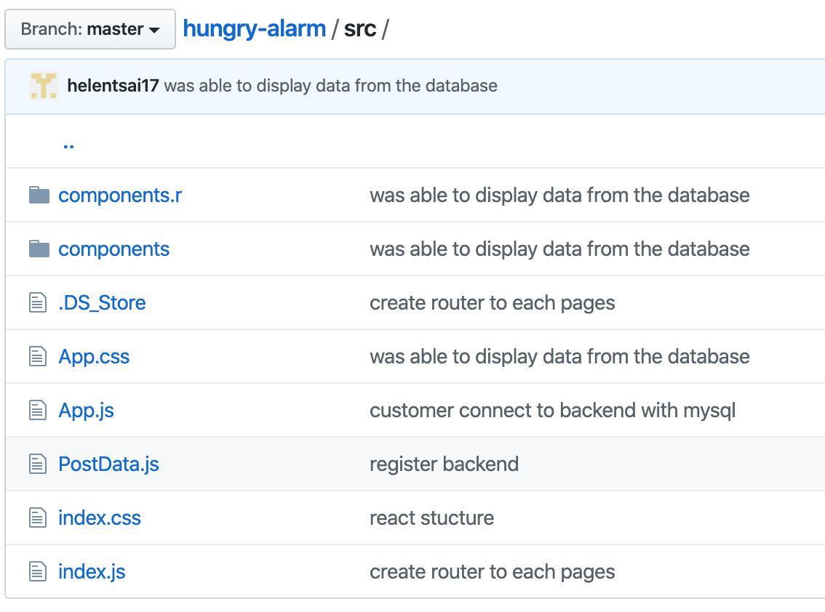
Source File Structure

Slide 6
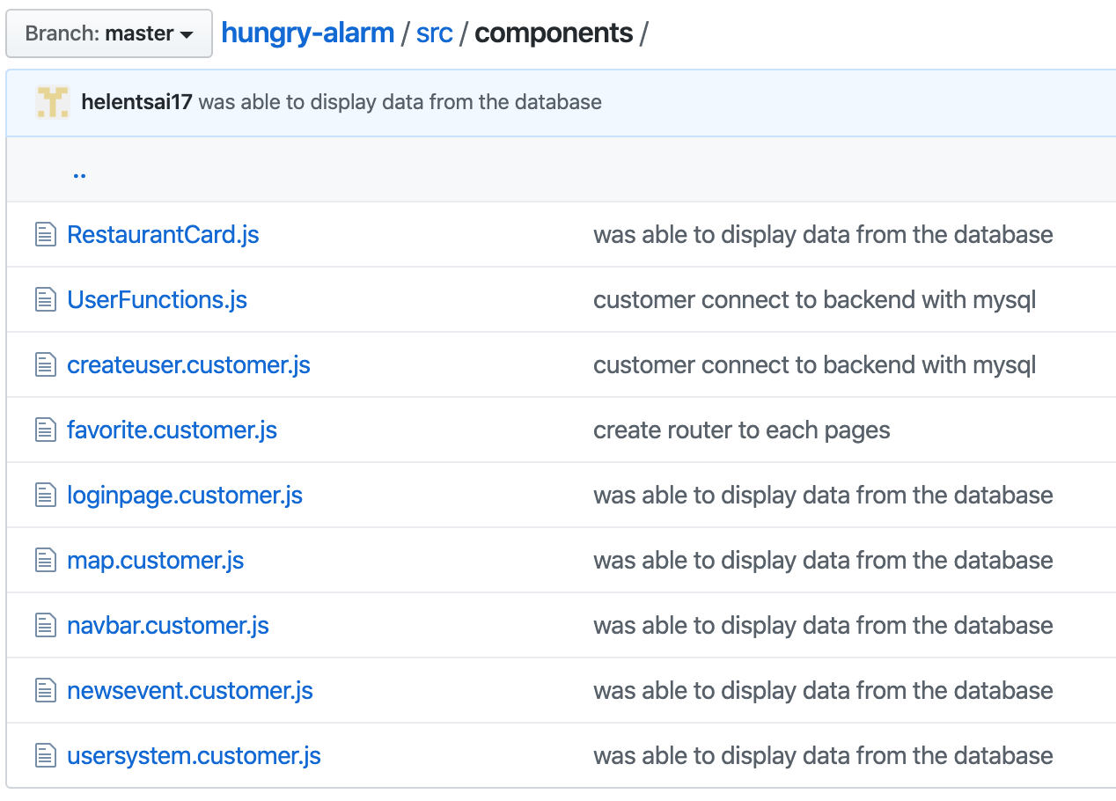
Components Structure

